Slide 1

Neural-Enhanced Live Streaming: Improving Live Video Ingest via Online Learning
Jaehong Kim*, Youngmok Jung*, Hyunho Yeo,
Juncheol Ye, Dongsu Han
*Co-first authors
Notes:
Hi, I’m Jaehong from KAIST.
In this video, I’m going to talk about Neural-Enhanced Live Streaming,
Improving Live Video Ingest via Online Learning.
This is a short 10 minute video and if you want to know the details,
please watch the 20 minute video.

Slide 2
Increase of Live Internet Video Traffic
Live video will reach 17 %
of the video traffic by 2022
* Ref: Cisco Visual Networking Index: Forecast and Trends, 2017–2022 White Paper
Notes:
Live video traffic has experienced a rapid growth with the rise of live streaming services
such as YouTube and Twitch.
With the number of streamers and viewers on the fast rise,
supporting high-quality live streaming has become evermore critical.

Slide 3








Live Video Delivery Workflow
Ingest Side
Distribution Side
Ingest
Distribute
1080p
Streamer
Media Server
CDNs
Transcode
Viewers
Quality
Bandwidth
Quality
1080p
ABR
720p
360p
Time
Time
Time
Notes:
Live streaming systems consist of two main components.
(click)
First, the ingest side concerns the delivery of live video from original streamer to a media server.
When the streamer uploads a high-quality live video to the media server,
(click)
the media server transcodes the ingest stream into video chunks with multiple different low qualities.
(wait & click)
Second, at the distribution side,
(click)
content distribution servers use adaptive bitrate streaming
to optimize the quality of experience and scale across thousands of concurrent viewers.

Slide 4

Key Limitations in Live Video Delivery
Network Congestion
Ingest
Distribute
Low Quality
< 1080p, 4K
Streamer
Media Server
CDNs
Encoding
Performance
Viewers
10K concurrent
The live stream quality is fundamentally constrained by:
  streamer’s uplink bandwidth
  streamer’s computational capacity
Notes:
However, there still exist key limitations in an end-to-end live video delivery.
The stream quality is fundamentally constrained by
(click)
the streamer’s uplink bandwidth
(click)
and its computational capacity.
(click)

Slide 5

Key Limitations in Live Video Delivery
Network Congestion
Ingest
Distribute
Low Quality
< 1080p, 4K
Streamer
Media Server
CDNs
Encoding
Performance
Viewers
10K concurrent
Transcode
Quality
Bandwidth
Quality
1080p
ABR
720p
360p
Time
Time
Time
Notes:
For example, if the network bandwidth between the streamer and the media server is scarce, (click)
or if the streamer lacks computing power on their devices to encode live stream in real-time, (click)
the ingest stream quality suffers by limiting the transcoded options (click) ,
and (click & wait) restricts the quality of the entire delivery downstream.

Slide 6
Key Limitations in Live Video Delivery
Network Congestion
Ingest
Distribute
Low Quality
< 1080p, 4K
Streamer
Media Server
CDNs
Encoding
Performance
Transcode
Viewers
10K concurrent
Quality
Bandwidth
Quality
1080p
ABR
Deprives thousands of viewers of their opportunity
to enjoy high-quality live stream !
720p
360p
Time
Time
Time
Notes:
This potentially deprives thousands of viewers of their opportunity to enjoy high-quality live stream.

Slide 7


LiveNAS: Scope & Goal
System : Ingest process
  first hop delivery between streamer – media server.
Distribute
Ingest
Streamer
Media Server
CDNs
Viewers
Goal : Enhance video quality of the origin stream at ingest
Notes:
Therefore, in this work, we focus on the first hop delivery between the streamer and the media server, (click)
namely the ingest
and we propose a new live ingest framework, called LiveNAS, that aims to enhance the video quality of origin stream at ingest.

Slide 8

Super-resolution at Live Ingest
Network Congestion
Ingest
< 1080p, 4K
Streamer
Media Server
CDNs
Encoding
Performance
Viewers
Super-resolution & Transcode
Benefit QoE of entire downstream
Quality
super-resolution
Quality
Bandwidth
Quality
Bandwidth
Quality
Bandwidth
ABR
Quality
ABR
ABR
Time
Time
Time
Time
Time
Time
Time
Time
Notes:
By leveraging the computing power at the ingest server,
(click)
LiveNAS applies super-resolution on the original ingest stream at the ingest-side
before its distribution to the end viewers.
Since the high-quality video is now available at the media server, (click)
this enables thousands of viewers to download high-quality live stream if they have enough bandwidth.

Slide 9
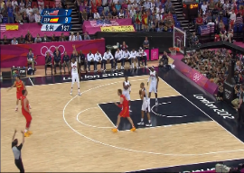
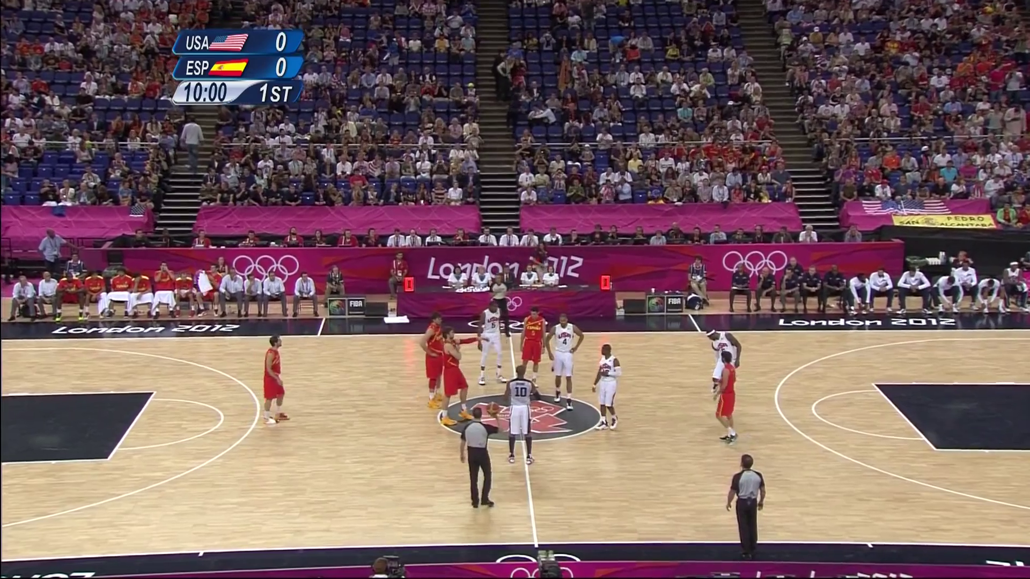

Two Primary Challenges (1)
  Content-aware DNNs cannot be prepared on the fly for the new live content
+ 4.5dB
+ 0.7dB
1 min of video
10 min of training
to prepare content-aware DNNs
Bilinear
Pre-trained
Content-aware
Pre-trained cannot provide
reliable quality gain.
Online training with fresh live data
Notes:
However, there are two primary challenges of applying super-resolution in live streaming.
(click)
First, content-aware DNNs cannot be prepared on the fly for the new live content.
It is known that super-resolution DNNs provide great benefit
when trained and used on the same content, namely the content-aware approach.
(click)
In fact, to prepare the content-aware DNN for per video,
it requires 10 minutes of training for a 1 minute of video.
The approach cannot be easily adopted to the live video delivery
considering its stringent delay requirement.
(click)
In addition, pre-training a DNN to a video from past live sessions cannot deliver reliable quality gain
compared to the content-aware DNNs.
This is because, the live content can be very new and different from history sessions.
(click)
To address the challenge, our solution is to employ online training with fresh data while live streaming.

Slide 10


Two Primary Challenges (2)
  Streamer-side lacks computing power for online training
Resource ↓
Leverage
computing power
at the Ingest server
But…
No ground-truth
labels
Resource ↑
Mobile Device
Media Server
Notes:
(click)
Second, to train the DNN online, it requires powerful computing devices but
the computing power at the streamer-side is heterogeneous.
(click)
Instead, we can leverage the computing power at the ingest server which is typically a cloud environment with ample computing resource.
(click)
However, the challenge is that ground-truth labels for online training are not available at the media server.

Slide 11
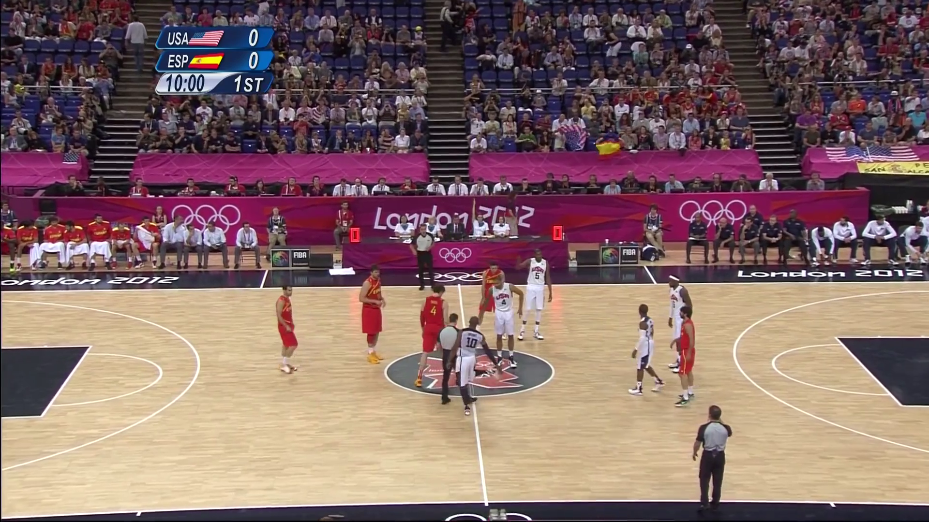
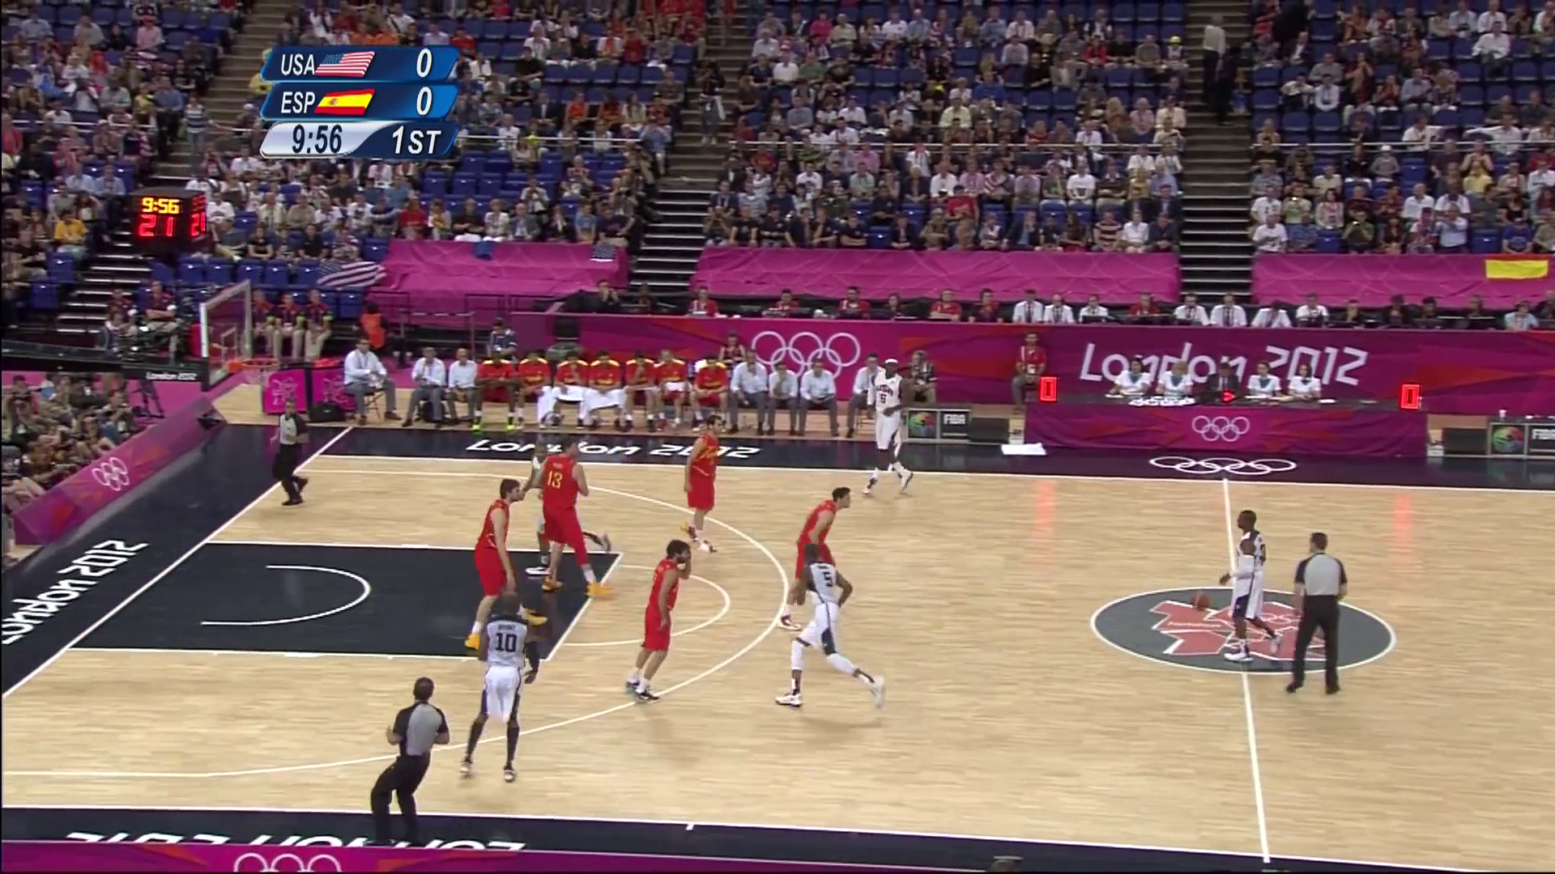
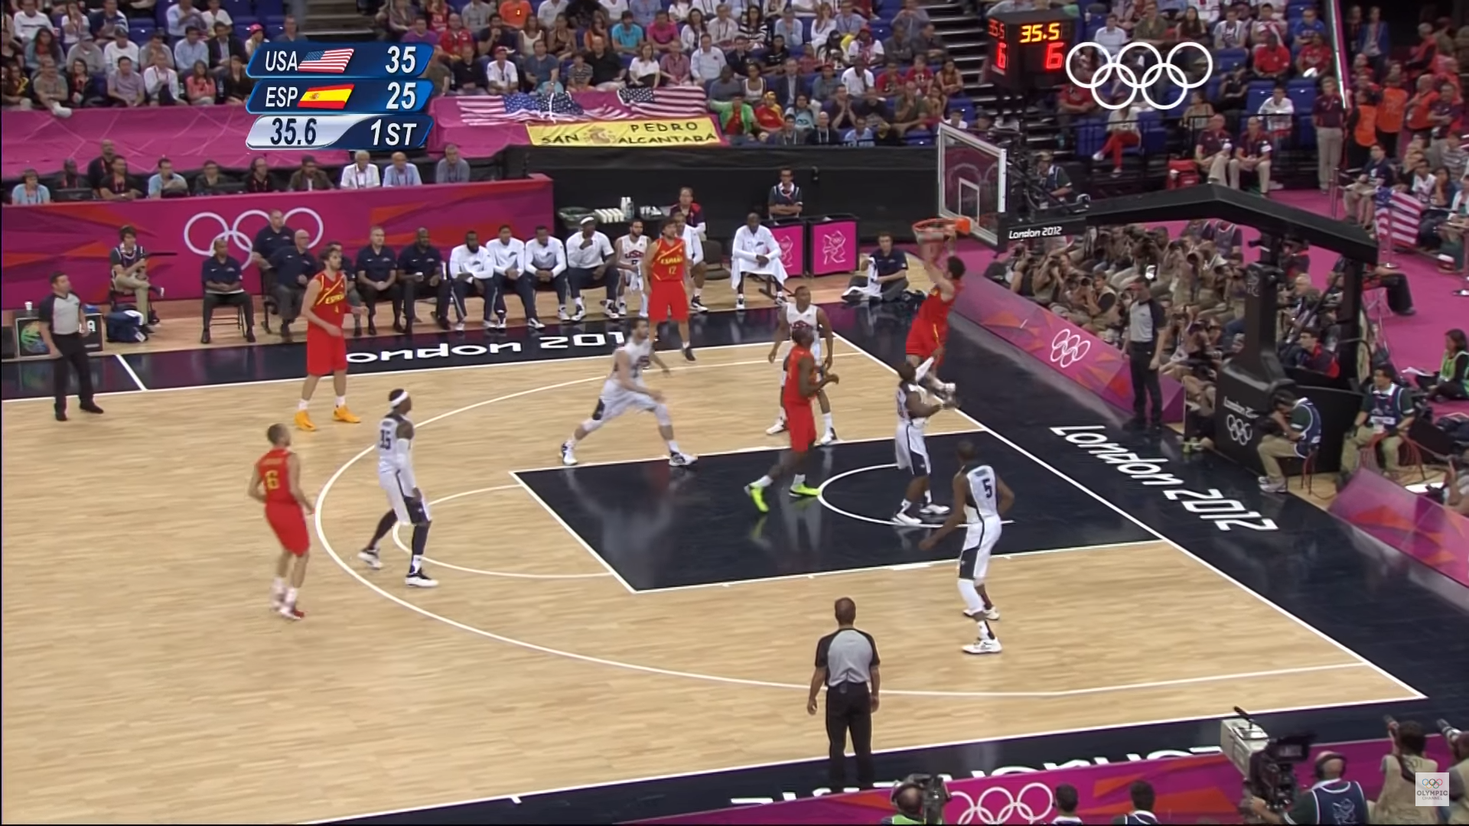
Fraction of Ground Truth Labels are Sufficient
Crop
into patches
30 frames / sec
1. Training with only a subset of frames
(< 30 fps) produces significant gain.
2. Training with a fraction of ground-truth labels
(i.e., patches) produces significant gain.
5% every 2 sec with JPEG compression = 124Kbps
Notes:
To address the challenge, we rely on our key observation that even a fraction of ground truth labels are sufficient for online training.
(click)
First, because video frames bear large redundancy,
training with only a subset of frames still produces almost the same quality gain
compared to having all frames.
(click)
Second, in addition to sampling of frames,
training with a fraction of ground truth labels, namely the patches,
still provides significant training gain.
Combining these two factors, we can transmit ground truth labels to the media server
using fairly small amount of bandwidth.
(click)
For example, sending 5% of frame for every 2 seconds with JPEG compression
requires only 124 (killo bit per second) (Kbps).

Slide 12
Two Primary Challenges (2)
  Streamer-side lacks computing power for online training
Resource ↓
Leverage
computing power
at the Ingest server
But…
No ground-truth
labels
Resource ↑
Mobile Device
Media Server
Streamer sends fractional training data to the ingest server
Notes:
Leveraging this, (click)
our solution is that the streamer sends fractional training data to the ingest server.

Slide 13
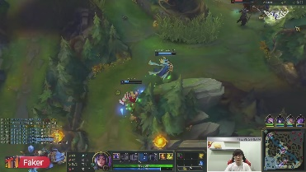












LiveNAS Approach : Online Learning at Ingest
Sampling
Capture
Update Parameters
Partial HR
Training Data
High-resolution (Raw)
(1080p, 4K)
Online Learning
Partial HR
Training Data
JPEG
Compression
Update Model
Streamer
Media Server
Super-resolution
Low-resolution
( < 1080p)
High-resolution
( >= 1080p)
Notes:
To explain in detail,
LiveNAS operates both at the streamer and the server-side.
At the streamer-side, (click)
the camera captures the high-quality stream before its compression
(click)
and LiveNAS samples partial high-resolution data which is used for training.
(click)
Then, the streamer sends the sampled training data patches along with the compressed live video frames.
At the media server,
the online training (click) and super-resolution inference (click) operate in parallel.
The online training learns new features of a video stream online (click)
with received patches from the streamer, (click)
and updates the freshly trained DNN to super-resolution processor.

Slide 14

Challenges of the Approach
1. Balancing allocation between video and training patches.
Quality Optimizing Scheduler
Streamer
Media Server
Training patches share bandwidth with live video
2. Supporting large number of streams at the Ingest Server.
Content Adaptive
Trainer
avg. 90K concurrent
streams
x 1 GPU
/ stream
avg. 95 min
/ stream
Efficient resource use is required
Notes:
The online training approach however involves solving non-trivial challenges.
First, (click) the high-quality patches that a client transmits
share the ingest-side bandwidth with live video. (click)
Allocating large bandwidth for training patches can improve super-resolution.
However, it leaves less bandwidth for live video, which can cause quality degradation.
(click)
To address the challenge we introduce the quality-optimizing scheduler
that effectively balances the allocation of uplink bandwidth between training patches and live video.
Second, (click) ingest server must support large number of streams.
(click)
For example, there are average 90 thousand concurrent streams on Twitch.
If we naively dedicate one GPU for online training to each stream,
LiveNAS can only provide benefit of online training to the limited number of concurrent streams.
Therefore, efficient resource use for online training is required.
(click)
To address the challenge we introduce the content-adaptive trainer.
Now, I’ll briefly explain the two design components.

Slide 15



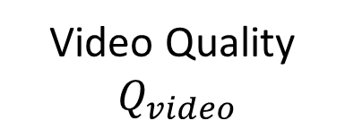


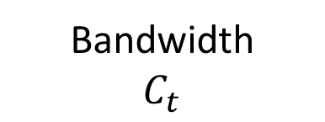
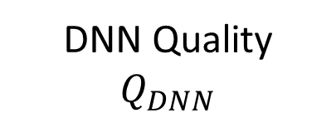
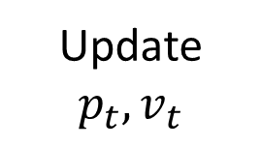
Quality-Optimizing Scheduler
Optimization Goal: maximize the sum of
video quality and future quality gain due to online training
Bandwidth
Video Quality ${ Q}_{video}$
Scheduler
$$C_{t}$$
Opt Goal
gradient ascent
Update
$$p_{t}, v_{t}$$
DNN Quality
$Q_{DNN}$
$$v_{t}$$
$${ Q}_{video}+ γ ∙Q_{DNN}$$
Patch Bitrate
$$p_{t}$$
Bandwidth
$$C_{t}$$
Time
Gradient
Value
Time
Given available bandwidth $C_{t},$
LiveNAS splits bandwidth use between video ($v_{t}$) and patches ($p_{t}$).
Notes:
The goal of quality optimizing scheduler,
is to allocate bandwidth use between the video and training patches
that results in maximum video quality.
(click)
Since we observe that the optimization goal is concave function,
our quality-optimizing scheduler applies gradient ascent
to find patch bitrate that leads to the maximum video quality
(click)
then the scheduler updates the target bitrate of patch and video respectively.

Slide 16
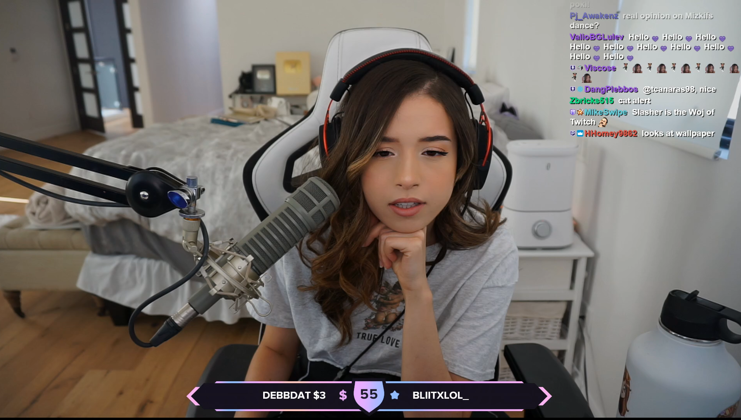
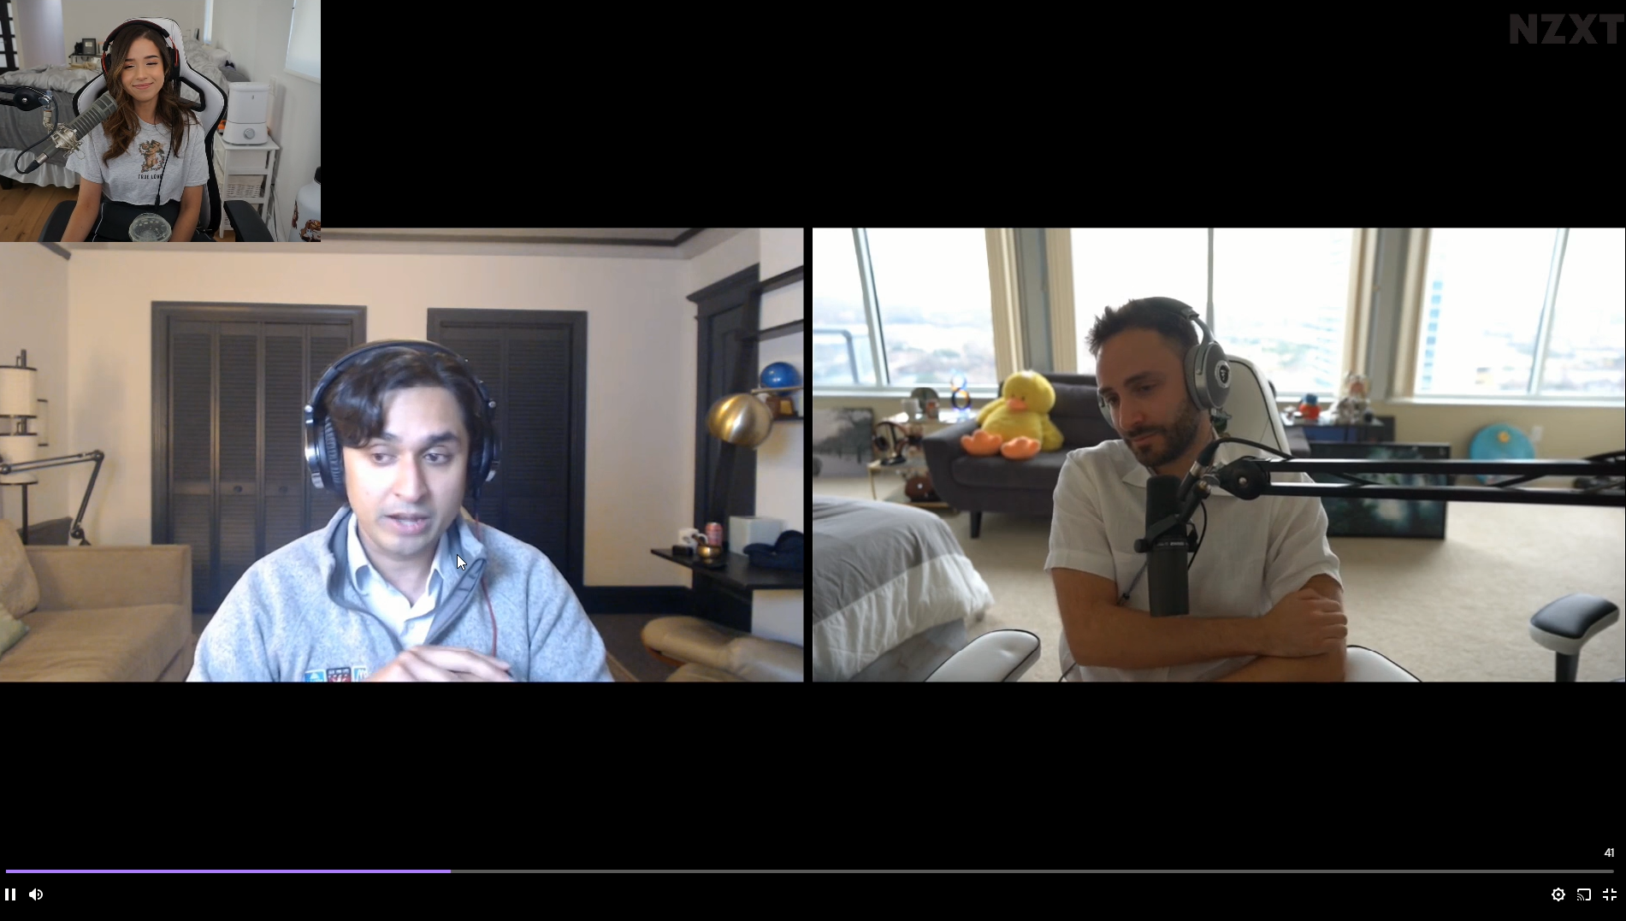
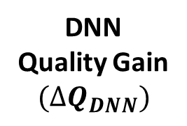
Content Adaptive Trainer
Scene transition
Just Chatting*
Just Chatting*
Video Call*
DNN
Quality Gain
$$(∆Q_{DNN})$$
Online training gain
cannot keep up with scene changes
Online training gain eventually saturates
Time
GPU
Usage
ON
Suspend
training
Resume
training
OFF
Time
LiveNAS adapts the amount of training time to the real-time quality gain.
*Ref: Twitch Streamer https://www.twitch.tv/pokimane/videos
Notes:
The goal of content-adaptive trainer is to improve the resource efficiency of the online training.
(click)
Our content-adaptive trainer suspends the training when it detects the saturation in the training gain
and resumes training when it detects the scene or content change.
(click)
In this way, LiveNAS is able to adapt the amount of training time to the real-time quality gain.

Slide 17




LiveNAS: Putting All Together
Streamer
Media Server
Raw
frames
Video bitrate
Quality optimizing scheduler
Quality feedback
Video
Downlink
Content-adaptive trainer
Video encoder
Patch bitrate
Online learning using patches
Updated model
Capture
Pacer
Super-resolution processor
Patch sampler
Patches (JPEG)
Uplink
Apply super-resolution to frames
: WebRTC (C++)
: LiveNAS (Python)
Notes:
Putting the design components all together,
here is the overview of LiveNAS system.
There are two additional design components
that I have not talked about in this video,
but they are explained in the 20 minute video.
LiveNAS is implemented on top of the state-of-the-art open-source ingest framework, WebRTC.
Besides the WebRTC, LiveNAS design components can be implemented on top of
any ingest framework since it is agnostic to video codec and transport layer.

Slide 18
Evaluation Summary
How much video quality improvement does LiveNAS deliver ?
: LiveNAS outperforms WebRTC by avg. 1.96 dB in PSNR
How effective is content-adaptive online learning ?
: LiveNAS delivers reliable quality gain with using 25% of GPU
resources compared to continuous training
What is the impact of LiveNAS on the distribution side ?
: LiveNAS produces significant (12%-69%) QoE improvement for live
stream viewers.
Notes:
We evaluated LiveNAS by answering the following three questions.
I will not go in to the details, since it is explained in the 20 minute video.
To summarize the results,
(click)
First, LiveNAS outperforms WebRTC by avg. 1.96 dB in PSNR under a constrained network environment.
(click)
Second, LiveNAS delivers reliable quality gain with using only 25% of GPU resource compared to continuous training.
(click)
Finally, LiveNAS produces 12-69% QoE improvement for live stream viewers.

Slide 19
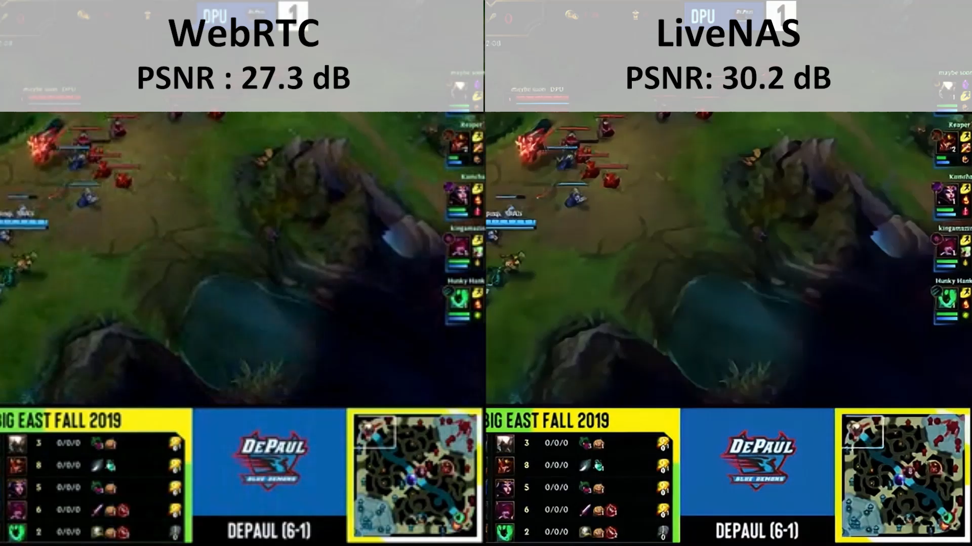
Notes:
Before ending this talk, (click) I would like to show you a demo.
The left half is what WebRTC delivers under a network constrained environment.
And the right half is what LiveNAS delivers under the same environment.
You can see that video is much clear in LiveNAS.

Slide 20
Conclusion
LiveNAS is a new live video ingest framework that enhances
the original stream’s quality via online learning.
LiveNAS introduces novel design components : quality-optimizing scheduler and content-adaptive trainer.
LiveNAS produces significant (12%-69%) QoE improvement for live stream viewers.
Our webpage : http://ina.kaist.ac.kr/~livenas/
Online learning using patches
Patches (JPEG)
Raw frames
(1080p, 4K)
Streamer
Media Server
Apply super-resolution to frames
Notes:
To sum up, I have briefly talked about three things in this talk.
First, LiveNAS is a new live video ingest framework that enhances the original stream’s quality via online learning.
Second, LiveNAS introduces novel design components including quality-optimizing scheduler and content-adaptive trainer.
Finally, LiveNAS produces significant (12%-69%) QoE improvement for live stream viewers.
More information can be found in our website.
Thank you for your attention and
If you have any questions, I’ll be happy to take them during the live Q&A session.

