Slide 1

Neural-Enhanced Live Streaming: Improving Live Video Ingest via Online Learning
Jaehong Kim*, Youngmok Jung*, Hyunho Yeo,
Juncheol Ye, Dongsu Han
*Co-first authors
Notes:
Hi, I’m Jaehong from KAIST.
In this video, I’m going to talk about Neural-Enhanced Live Streaming,
Improving Live Video Ingest via Online Learning.

Slide 2
Increase of Live Internet Video Traffic
Live video will reach 17 %
of the video traffic by 2022
* Ref: Cisco Visual Networking Index: Forecast and Trends, 2017–2022 White Paper
Notes:
Live video traffic has experienced a rapid growth with the rise of live streaming services,
such as YouTube Live, Twitch.tv and Facebook Live.
(click)
According to the market report,
the live video traffic will increase 15 fold and take up 17 percent of Internet video traffic by 2022.
With the number of streamers and viewers on the fast rise,
supporting high-quality live streaming has become evermore critical.

Slide 3








Live Video Delivery Workflow
Ingest Side
Distribution Side
Ingest
Distribute
1080p
Streamer
Media Server
CDNs
Transcode
Viewers
Quality
Bandwidth
Quality
1080p
ABR
720p
360p
Time
Time
Time
Notes:
Live streaming systems consist of two main components.
(click)
First, the ingest side concerns the delivery of live video from original streamer to a media server.
When the streamer uploads a high-quality live video to the media server,
(click)
the media server transcodes the ingest stream into video chunks with multiple different low qualities.
(wait & click)
Second, at the distribution side,
(click)
content distribution servers use adaptive bitrate streaming
to optimize the quality of experience and scale across thousands of concurrent viewers.

Slide 4

Key Limitations in Live Video Delivery
Network Congestion
Ingest
Distribute
Low Quality
< 1080p, 4K
Streamer
Media Server
CDNs
Encoding
Performance
Viewers
10K concurrent
The live stream quality is fundamentally constrained by:
  streamer’s uplink bandwidth
  streamer’s computational capacity
Notes:
However, there still exist key limitations in an end-to-end live video delivery.
The stream quality is fundamentally constrained by
(click)
the streamer’s uplink bandwidth
(click)
and its computational capacity.
(click)

Slide 5

Key Limitations in Live Video Delivery
Network Congestion
Ingest
Distribute
Low Quality
< 1080p, 4K
Streamer
Media Server
CDNs
Encoding
Performance
Viewers
10K concurrent
Transcode
Quality
Bandwidth
Quality
1080p
ABR
720p
360p
Time
Time
Time
Notes:
For example, if the network bandwidth between the streamer and the media server is scarce, (click)
or if the streamer lacks computing power on their devices to encode live stream in real-time, (click)
the ingest stream quality suffers by limiting the transcoded options (click) ,
and (click & wait) restricts the quality of the entire delivery downstream. (click)

Slide 6
Key Limitations in Live Video Delivery
Network Congestion
Ingest
Distribute
Low Quality
< 1080p, 4K
Streamer
Media Server
CDNs
Encoding
Performance
Transcode
Viewers
10K concurrent
Quality
Bandwidth
Quality
1080p
ABR
Deprives thousands of viewers of their opportunity
to enjoy high-quality live stream !
720p
360p
Time
Time
Time
Notes:
This potentially deprives thousands of viewers of their opportunity to enjoy high-quality live stream.

Slide 7


LiveNAS: Scope & Goal
System : Ingest process
  first hop delivery between streamer – media server.
Distribute
Ingest
Streamer
Media Server
CDNs
Viewers
Goal : Enhance video quality of the origin stream at ingest
Notes:
Therefore, in this work, we focus on the first hop delivery between the streamer and the media server,
namely the ingest.
We propose a new live ingest framework, called LiveNAS, that aims to enhance the video quality of origin stream at ingest.

Slide 8
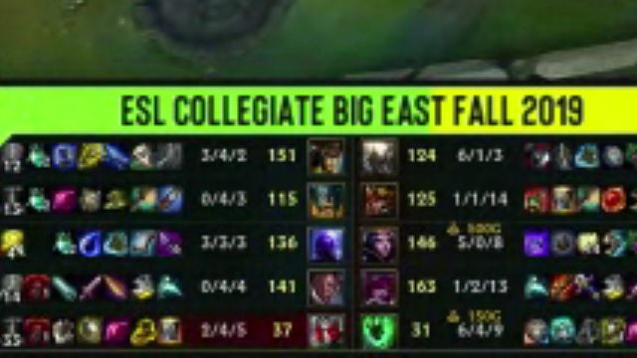



Benefit of Super-resolution on Video Streaming
DNN-based
super-resolution
Low resolution (PSNR= 25.5 dB)
High resolution (PSNR= 30 dB)
Super-resolution enhances video quality independent to network bandwidth*.
Bandwidth
Quality
Quality
super-resolution
ABR
Time
Time
Time
* Ref: NAS [OSDI’ 18]
Notes:
Recent advances in neural-enhanced video delivery
present a unique opportunity to enhance the video quality by applying DNN-based super-resolution on video frames.
Leveraging the great benefit of DNN-based super-resolution, (click)
NAS shows that super-resolution enhances video quality independent to network bandwidth.
It uses the client computation (click) and applies super-resolution DNNs to the downloaded chunks. (click)

Slide 9
Benefit of Super-resolution on Video Streaming
DNN-based
super-resolution
Can the similar benefit of super-resolution
be applied to the live streaming context ?
Low resolution (PSNR= 25.5 dB)
High resolution (PSNR= 30 dB)
Super-resolution enhances video quality independent to network bandwidth*.
Bandwidth
Quality
Quality
super-resolution
ABR
Time
Time
Time
* Ref: NAS [OSDI’ 18]
Notes:
Inspired by the previous work, we ask ourselves
can the similar benefit of super-resolution be applied to the live streaming context ?

Slide 10
Benefit of Super-resolution at Live Ingest (1)
Network Congestion
Ingest
< 1080p, 4K
Streamer
Media Server
CDNs
Encoding
Performance
Viewers
Super-resolution & Transcode
Benefit QoE of entire downstream
Quality
super-resolution
Quality
Bandwidth
Quality
Bandwidth
Quality
Bandwidth
ABR
Quality
ABR
ABR
Time
Time
Time
Time
Time
Time
Time
Time
Notes:
And our answer is LiveNAS.
By leveraging the computing power at the ingest server,
(click)
we can apply super-resolution on the original ingest stream at the ingest-side
before its distribution to the end viewers.
Since the high-quality video is now available at the media server, (click)
this enables thousands of viewers to download high-quality live stream if they have enough bandwidth themselves.

Slide 11
Benefit of Super-resolution at Live Ingest (2)
Live streaming (WebRTC) uses the
ingest-side bandwidth conservatively (55-64%).
Super-resolution provides benefit comparable to having 1.5x - 2x of the bandwidth!
Super-resolution is even more attractive in live streaming
Notes:
Moreover, super-resolution is expected to provide much more benefit
at the ingest than it does at the distribution.
(click)
Let me show you the figure that compares the bandwidth use between WebRTC and DASH.
WebRTC is a de-facto standard for live ingest,
and DASH is a de-facto standard for adaptive streaming.
(click)
We can notice that live streaming uses the bandwidth more conservatively.
This is because
first, the ingest client must avoid packet loss to minimize the latency due to retransmission.
and second,
unlike adaptive streaming, ingest servers cannot use buffer to absorb the network changes.
(click)
Fortunately,
when we apply super-resolution at live ingest,
it provides benefit comparable to having almost 2 times of the bandwidth.
This is greater benefit considering that NAS provides benefit comparable to having 17% more bandwidth.
(click)
Therefore, the benefit of super-resolution is even more attractive in live streaming.

Slide 12
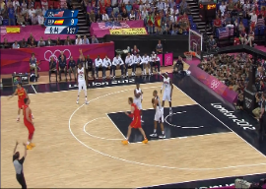
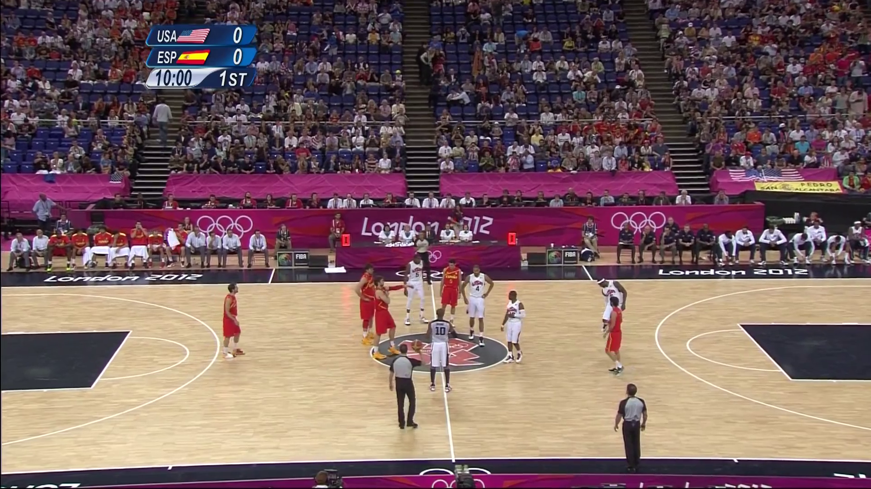

Two Primary Challenges (1)
  Content-aware DNNs cannot be prepared on the fly for the new live content
+ 4.5dB
+ 0.7dB
1 min of video
10 min of training
to prepare content-aware DNNs
Bilinear
Pre-trained
Content-aware
Pre-trained cannot provide
reliable quality gain.
Online training with fresh live data
Notes:
However, there are two primary challenges of applying super-resolution in live streaming.
(click)
First content-aware DNNs cannot be prepared on the fly for the new live content.
In DNN-based super-resolution, it is known that super-resolution DNN provides great benefit
when trained and used on the same content, namely content-aware approach.
(click)
In fact, to prepare the content-aware DNN for per video,
it requires 10 minutes of training for a 1 minute of video.
The approach cannot be easily adopted to the live video delivery
considering its stringent delay requirement.
(click)
In addition, pre-training a DNN to a video from past live sessions cannot deliver reliable quality gain
compared to the content-aware DNNs.
This is because, the live content can be very new and different from history sessions.
(click)
To address the challenge, our solution is to employ online training with fresh data while live streaming.

Slide 13


Two Primary Challenges (2)
  Streamer-side lacks computing power for online training
Resource ↓
Leverage
computing power
at the Ingest server
But…
No ground-truth
labels
Resource ↑
Mobile Device
Media Server
Streamer sends fractional training data to the ingest server
Notes:
(click)
Second, to train the DNN online it requires powerful computing devices but
the computing power at the streamer-side is heterogeneous.
(click)
Instead, we can leverage the computing power at the ingest server which is typically a cloud environment with ample computing resource.
(click)
However, the challenge is that ground-truth labels for online training are not available at the media server.
To address the challenge, we rely on our key observation that even a fraction of ground truth labels can provide substantial training gains.
(click)
Leveraging this, our solution is that the streamer sends fractional training data to the ingest server.

Slide 14
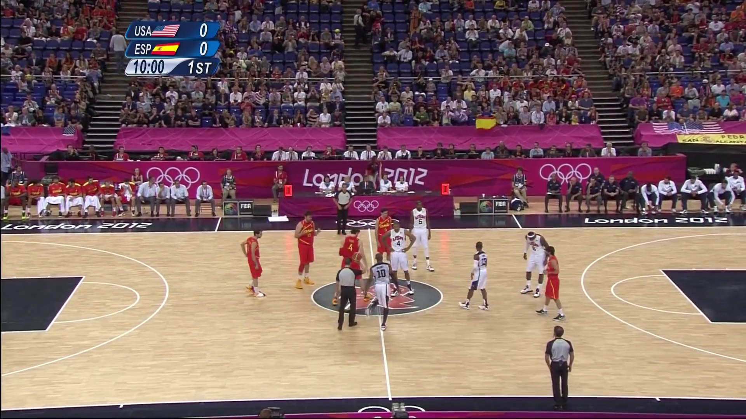
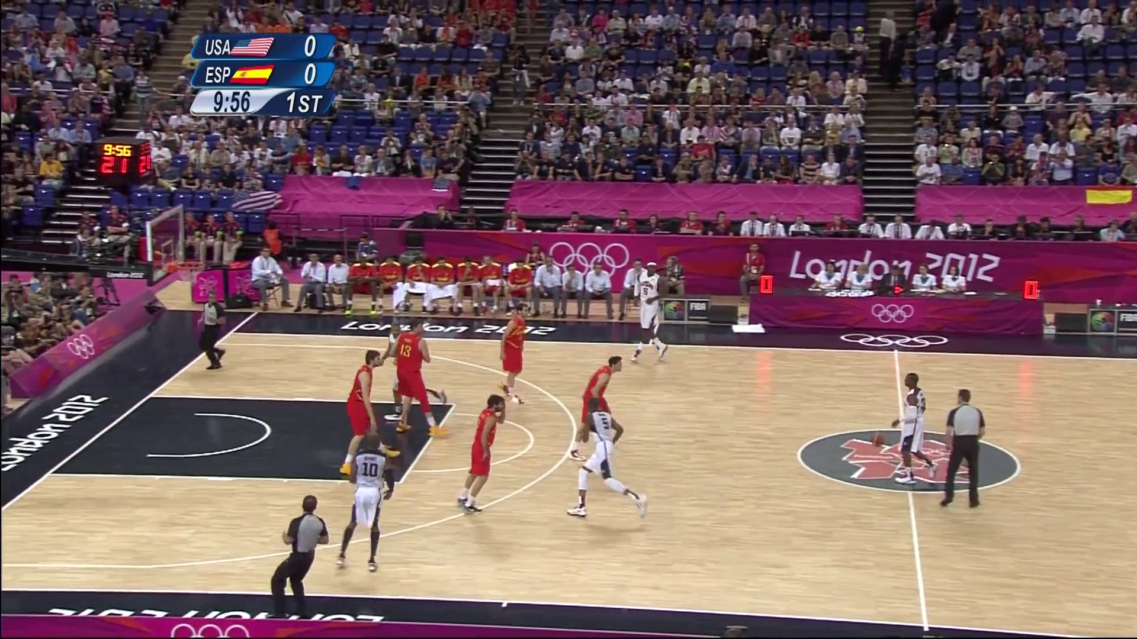


LiveNAS Approach : Online Learning at Ingest
Sampling
Capture
Partial HR
Training Data
High-resolution (Raw)
(1080p, 4K)
JPEG
Compression
Streamer
Media Server
Update Parameters
Partial HR
Training Data
Output
Target
Notes:
To explain in detail,
LiveNAS operates both at the streamer and the server-side.
At the streamer-side, (click)
the camera captures the high-quality stream before its compression
(click)
and LiveNAS samples partial high-resolution data which is used for training.
(click)
Then, the streamer sends the sampled training data patches along with the compressed live video frames.
At the media server,
the online training and inference operate in parallel.
(click)
The online training learns new features of a video stream online
with received patches from the streamer,
and updates the freshly trained DNN to super-resolution processor.

Slide 15

Challenges of the Approach
1. Balancing allocation between video and training patches.
Quality Optimizing Scheduler
Streamer
Media Server
Training patches share bandwidth with live video
2. Supporting large number of streams at the Ingest Server.
Content Adaptive
Trainer
avg. 90K concurrent
streams
x 1 GPU
/ stream
avg. 95 min
/ stream
Efficient resource use is required
Notes:
The online training approach however involves solving non-trivial challenges.
First, (click) the high-quality patches that a client transmits
share the ingest-side bandwidth with live video. (click)
Allocating large bandwidth for training patches can improve super-resolution.
However, it leaves less bandwidth for live video, which can cause quality degradation.
(click)
To address the challenge we introduce the quality-optimizing scheduler
that effectively balances the allocation of uplink bandwidth between training patches and live video.
Second, (click) ingest server must support large number of streams.
(click)
For example, there are average 90 thousand concurrent streams on Twitch.
If we naively dedicate one GPU for online training to each stream for the entire stream duration,
LiveNAS can only provide benefit of online training to the limited number of concurrent streams.
Therefore, efficient resource use for online training is required.
(click)
To address the challenge we introduce the content-adaptive trainer.
Now, let’s look at the these two design components in detail.

Slide 16



Quality-Optimizing Scheduler (1)
Optimization Goal: maximize sum of
video quality and future quality gain due to online training
Future
DNN Quality
gradient ascent
Video Quality
Opt Goal
$${ Q}_{video}$$
$$γ ∙Q_{DNN}$$
$${ Q}_{video}+ γ ∙Q_{DNN}$$
Video Bitrate
Patch Bitrate
Patch Bitrate
Concave function
Concave function
Concave function
Approach : gradient ascent
Notes:
The goal of quality optimizing scheduler,
is to allocate bandwidth use between video and training patches
that results in maximum video quality.
The optimization goal (click) is expressed as the sum of video quality and the future discounted quality gain
due to online training.
We observe that the optimization objective is concave function.
(click)
First, the video quality function is concave as video quality with regard to the bitrate is concave.
(click)
Second, the DNN quality function is also concave
because it monotonically increases with respect to increase in the training set,
yet the marginal improvement diminishes.
Since any linear combination of concave functions is concave, (click)
our optimization objective is concave function.
This allows us to apply gradient ascent approach. (click)

Slide 17



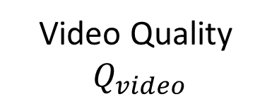



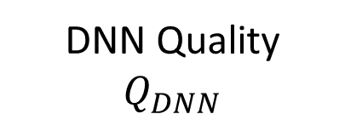
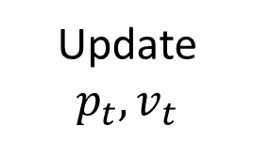
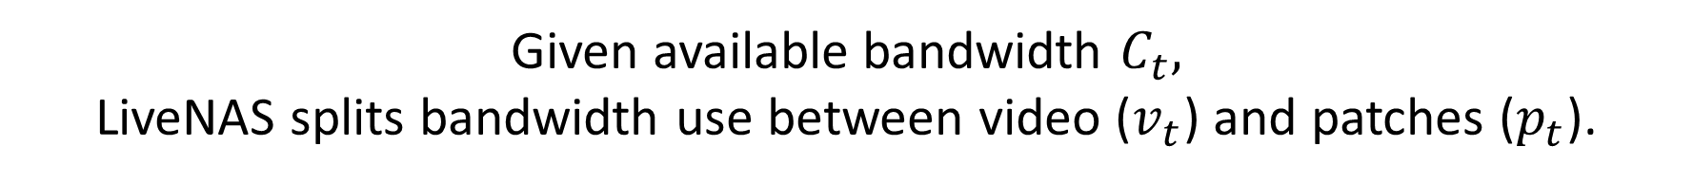
Quality-Optimizing Scheduler (2)
Given available bandwidth $C_{t},$
LiveNAS splits bandwidth use between video ($v_{t}$) and patches ($p_{t}$).
Bandwidth
Video Quality ${ Q}_{video}$
Scheduler
$$C_{t}$$
Opt Goal
gradient ascent
Update
$$p_{t}, v_{t}$$
DNN Quality
$Q_{DNN}$
$$v_{t}$$
$${ Q}_{video}+ γ ∙Q_{DNN}$$
Patch Bitrate
$$p_{t}$$
Bandwidth
$$C_{t}$$
Time
Gradient
Value
Time
Notes:
Therefore, (click)
our quality-optimizing scheduler applies gradient ascent
to find patch bitrate that leads to the maximum video quality.
(click)
The scheduler takes measurements of video quality, DNN quality improvement,
and the estimate of available bandwidth from the transport layer.
(click)
Then it updates the target bitrate of patch and video respectively.

Slide 18
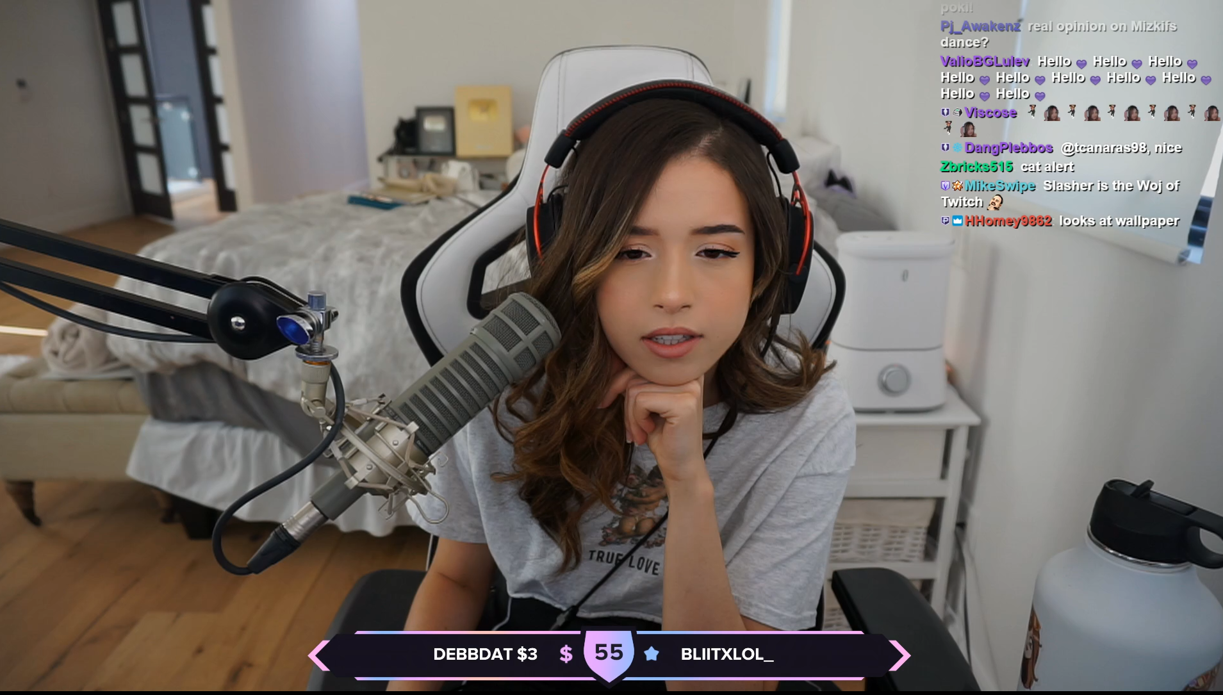
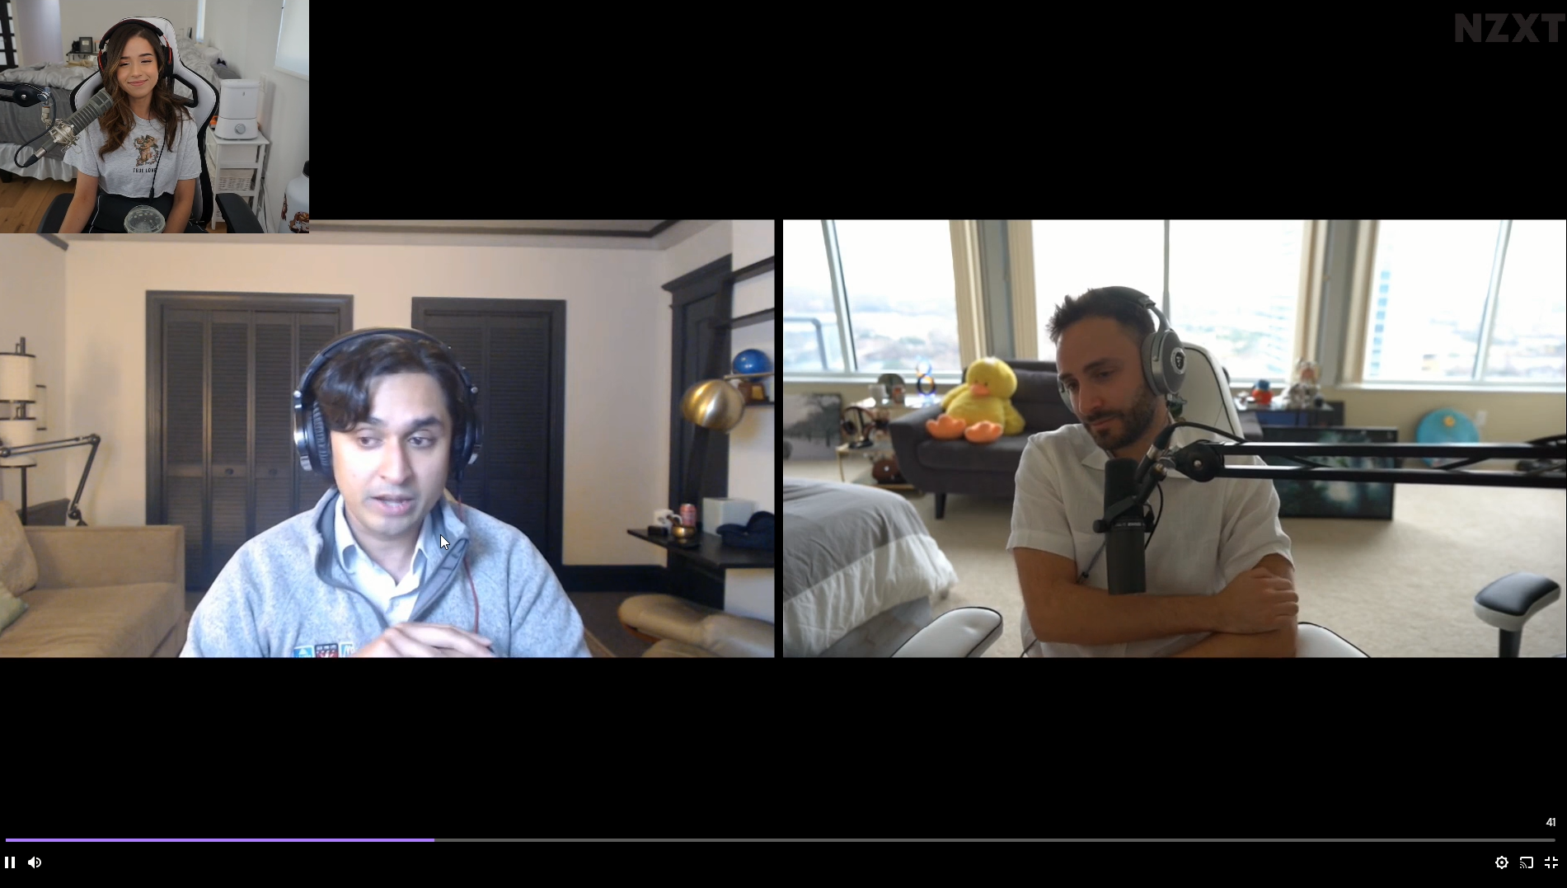
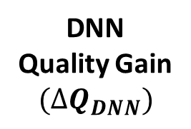
Content Adaptive Trainer
Scene transition
Just Chatting*
Just Chatting*
Video Call*
DNN
Quality Gain
$$(∆Q_{DNN})$$
Online training gain
cannot keep up with scene changes
Online training gain eventually saturates
Time
GPU
Usage
ON
Suspend
training
Resume
training
OFF
Time
LiveNAS adapts the amount of training time to the real-time quality gain.
*Ref: Twitch Streamer https://www.twitch.tv/pokimane/videos
Notes:
The goal of content-adaptive trainer is to improve the resource efficiency of the online training.
Our observation shows that for videos with minimal scene change (click) (click)
the online training gain eventually saturates to the point (click) where further training may not provide benefit.
However, when a new content appears, (click)
the online trained DNNs cannot keep up with the scene change (click) and therefore
it needs additional training.
Thus, real-time adaptation to the content can improve the resource-efficiency.
(click)
Our content-adaptive trainer suspends the training when it detects the saturation
in the training gain and resumes training when it detects the scene or content change.
(click)
In this way, LiveNAS is able to adapt the amount of training time to the real-time quality gain.

Slide 19
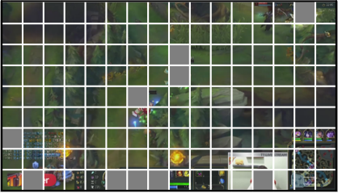
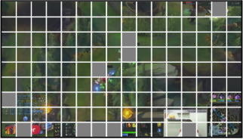










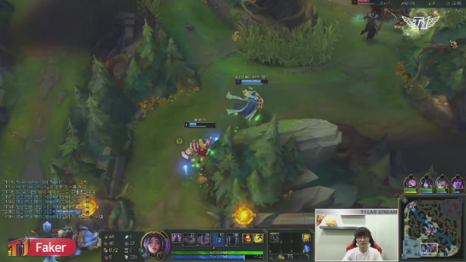




Additional Design Components
Patch sampler: selects high-quality labels that provide larger training gain
Bilinear up-scale
Sampled
raw patches
Encoded patch
Low-resolution
Quality
Raw patch (120x120)
High-resolution
Patch sampler
Super-resolution processor: enables real-time super-resolution up to 4K
Split into
3 pieces
Inference Latency : 29ms (= 34 fps)
1080p Original Ingest
x3 GPUs
Stitch back to 4K
Notes:
So far, we’ve talked about two main design components.
Additionally, there are two remaining components in LiveNAS
that deals with selection of training data and real-time super-resolution.
(click)
One of them is a patch sampler which operates at the streamer-side
and selects the high-quality labels to be transmitted.
(click)
It preferentially selects the ones that make training gain to appear as large as possible,
by including the patches that are more difficult to encode.
This is because the patches that are more difficult to encode have room for more improvement.
(click)
The other is super-resolution processor which operates at the server-side
and enables the real-time super-resolution up to 4K resolutions.
For example, in case for the 4K super-resolution,
the processor splits up the original ingest image into three equal pieces (click)
and then individually apply super-resolution using three GPUs. (click)
Then, the outputs are stitched back to produce 4K image. (click)
This takes 29ms per frame which translates to 34fps.

Slide 20




LiveNAS: Putting All Together
Streamer
Media Server
Raw
frames
Video bitrate
Quality optimizing scheduler
Quality feedback
Video
Downlink
Content-adaptive trainer
Video encoder
Patch bitrate
Online learning using patches
Updated model
Capture
Pacer
Super-resolution processor
Patch sampler
Patches (JPEG)
Uplink
Apply super-resolution to frames
: WebRTC (C++)
: LiveNAS (Python)
Notes:
Putting the design components all together,
here is the overview of LiveNAS system.
LiveNAS is implemented on top of the state-of-the-art open-sourced ingest framework, WebRTC. (click)
We implemented LiveNAS server and client in python to utilize Pytorch framework (click)
and used a python C++ wrapper to integrate LiveNAS and WebRTC.
Besides the WebRTC, LiveNAS design components can be implemented on top of
any ingest framework since it is agnostic to video codec and transport layer.

Slide 21
Evaluation
How much video quality improvement does LiveNAS deliver ?
How effective is content-adaptive online learning?
What is the impact of LiveNAS on the distribution side?
Notes:
We now evaluate LiveNAS by answering three questions.
First, we show how much video quality improvement LiveNAS can deliver under a constrained environment.
Second, we show how effective is content-adaptive online learning in terms of the resource efficiency.
Finally, we show the impact of the ingest improvement of LiveNAS on the distribution side.

Slide 22



Evaluation Setup
Real-world network traces: from 2019 FCC U.S. broadband uplink
Videos: top 5 Twitch Contents, 4 YouTube Contents
Computing device: two Geforce RTX 2080 Ti GPUs
Ingest resolution: followed the YouTube Live settings
Target resolution: 1080p(Twitch), 4K(YouTube)
Mahimahi
Streamer
(WebRTC Client)
Media Server
Notes:
Our evaluation consists over 300 hours of live stream using the real network traces
collected from 2019 FCC broadband.
We used total 9 video contents, which consist of top 5 contents from Twitch and 4 popular contents from YouTube.
For the super-resolution DNN model, we use the Ultra-high model from NAS.
We chose the ingest resolution following the YouTube Live settings
and the target resolutions are 1080p and 4K for Twitch and YouTube contents respectively.

Slide 23
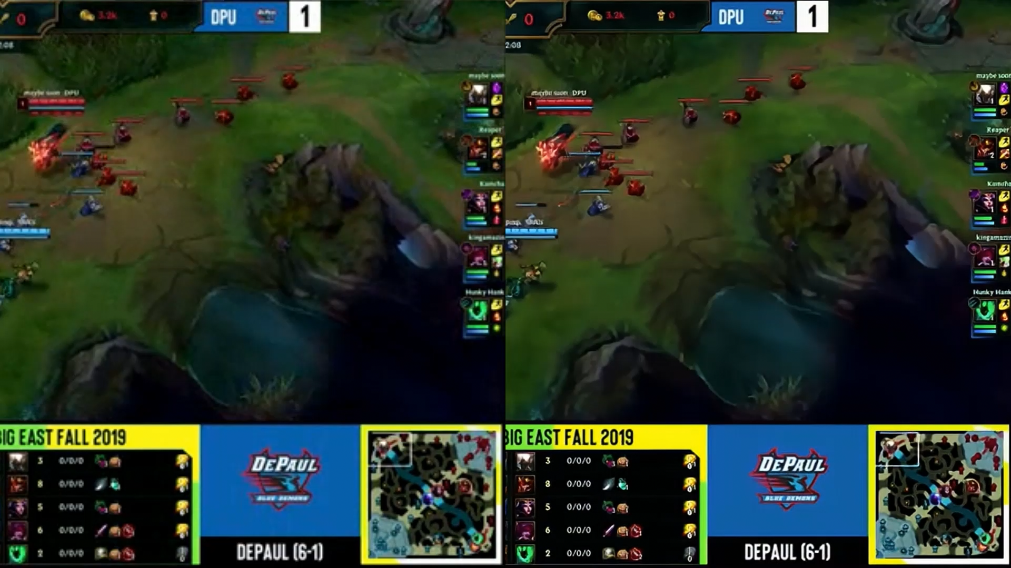
WebRTC
LiveNAS
Notes:
Before presenting the results, (click) I would like to show you a demo.
In this demo, it shows the actual recorded live stream of two most popular contents on Twitch.
The left half is what WebRTC delivers under a network constrained environment.
And the right half is what LiveNAS delviers under the same environment.
You can see that video is much clear in LiveNAS.
Next I’ll show how much video quality improvement LiveNAS delivers.

Slide 24
Video Quality Improvement
Twitch Contents
avg. uplink bandwidth : 0.6 Mbps
360p (original) → 1080p (target)
YouTube Contents
avg. uplink bandwidth : 2.8 Mbps
720p (original) → 4K (target)
LiveNAS outperforms WebRTC by avg. 1.96 dB in PSNR
Notes:
To quantify the video quality improvement,
we use PSNR which is widely used metric for video quality.
We compare LiveNAS with three baselines.
First baseline is WebRTC which does not utilize DNNs but uses bilinear interpolation to scale up to target resolution.
Second baseline is Generic DNN which uses a super-resolution DNN trained on a standard benchmark dataset.
The last baseline is Pre-trained DNN which uses a prior stream, if available, from the same streamer, to pre-train the model.
(click)
Left-hand side presents the result of the 5 twitch contents
and x axis is the content name.
(click)
Right-hand side presents the result of the 4 YouTube contents
The result shows that LiveNAS outperforms both WebRTC and Generic DNN baselines.
For the Twitch contents, LiveNAS outperforms the pre-trained model except for the Fortnite content whose quality was nearly the same as pre-trained.
However, this result only appears when the best train data is carefully selected from the prior stream.
(click)
Overall, LiveNAS outperforms WebRTC by avg. 1.96 dB and generic super-resolution by avg. 1.19dB in PSNR.

Slide 25
Resource Efficiency and Cost
Continuous
LiveNAS
One-time
Customization
Better
WebRTC
0.9
1
Cost: $4.69/hour per stream on Google Cloud (16 vCPU, 4 Tesla V100 GPUs)
LiveNAS delivers reliable quality gain with using
25% of GPU resources compared to continuous training
Notes:
We now show you how much resource that content-adaptive learning can save.
(click)
Here, the figure shows the actual GPU usage time for online training
compared to the stream length.
On average, LiveNAS performs online learning for only 25% of the streaming time.
To see how effective the content-adaptive learning is,
we compare LiveNAS and WebRTC with two baseline training methods
in terms of resulting video quality. (click)
First baseline is the one-time customization (click)
which trains DNN upfront on the first few seconds of the stream
and never resumes even when scene or content changes.
Second baseline is continuous online training (click)
which trains DNN continuously without any suspension.
The training time is identical to the stream length.
(click)
LiveNAS delivers almost the same quality while using 25% of GPU resources compared to continuous training.
One-time customization, however, comes at a significant decrease in quality because it does not keep up with scene changes.
(click)
When we quantify the computation cost for LiveNAS,
the average cost is around 4.7 dollars per hour per stream on Google Cloud.

Slide 26
QoE Improvement on Distribution Side
FCC broadband traces
(avg. bandwidth: 72 Mbps)
Pensieve traces
(avg. bandwidth = 1.48 Mbps)
Pensieve: +13%
LiveNAS: +27%
Twitch
YouTube
Twitch
YouTube
LiveNAS produces significant (12%-69%) QoE improvement
for live stream viewers.
Notes:
Finally, we show you the impact of LiveNAS on the distribution side.
To quantify this, we measure the QoE of viewers at the distribution side.
(click)
We used Pensieve and robustMPC as the adaptive bitrate (ABR) algorithm
and simulated adaptive streaming on two traces.
(click)
One is the downlink traces from FCC broadband
(click)
The other is the traces from Pensieve.
(click)
Overall, LiveNAS ingest delivers 12 - 69% improvement in average QoE on distribution side.
The improvement comes from two reasons.
First, LiveNAS provides higher resolution chunks benefiting viewers who have ample bandwidth.
Second, each encoded chunk is of better quality because ingest video quality improves with LiveNAS.
In many cases, the improvement LiveNAS gives is much larger than what the advanced ABR algorithm produces.
For example, Pensieve’s improvement over robustMPC is 13% for Twitch video. (click)
But LiveNAS gives 27% improvement over WebRTC ingest on the same traces. (click)
This implies that in live streaming, ingest-side improvement is crucial
and it is as important as ABR algorithms for enhancing the QoE of end viewers.

Slide 27
Conclusion
Online learning using patches
Patches (JPEG)
Raw frames
(1080p, 4K)
Streamer
Media Server
Apply super-resolution to frames
LiveNAS is a new live video ingest framework that enhances
the original stream’s quality via online learning.
LiveNAS introduces novel design components : quality-optimizing scheduler and content-adaptive trainer.
LiveNAS produces significant (12%-69%) QoE improvement for live stream viewers.
Our webpage : http://ina.kaist.ac.kr/~livenas/
Notes:
To sum up, I have talked about three things in this talk.
First, LiveNAS is a new live video ingest framework that enhances the original stream’s quality via online learning.
Second, LiveNAS introduces novel design components including quality-optimizing scheduler and content-adaptive trainer.
Finally, LiveNAS produces significant (12%-69%) QoE improvement for live stream viewers.
More information can be found in our website.
Thank you for your attention and
If you have any questions, I’ll be happy to take them during live Q&A session at the conference.

